Slide 1
Construction of an Airport on a Private Island
INSE 6230
Jeevesh Awal 40169864
Lakshay Bareja 40156832
Darshan Mina 40138514
Devanshi Rajpara 40164374
Rida Rais 40161813
Nithish Reddy 40164619

Slide 2
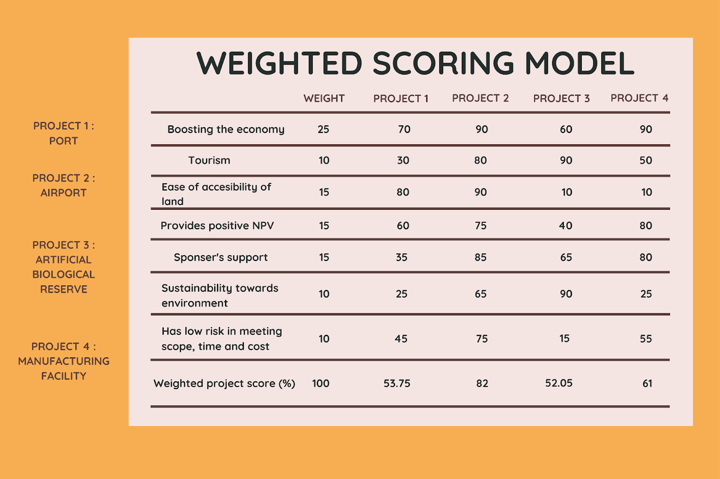
Why we Chose this Project?
We took into account few possible projects and compare and contrasted them to find out which will be the most rewarding project.

Slide 3
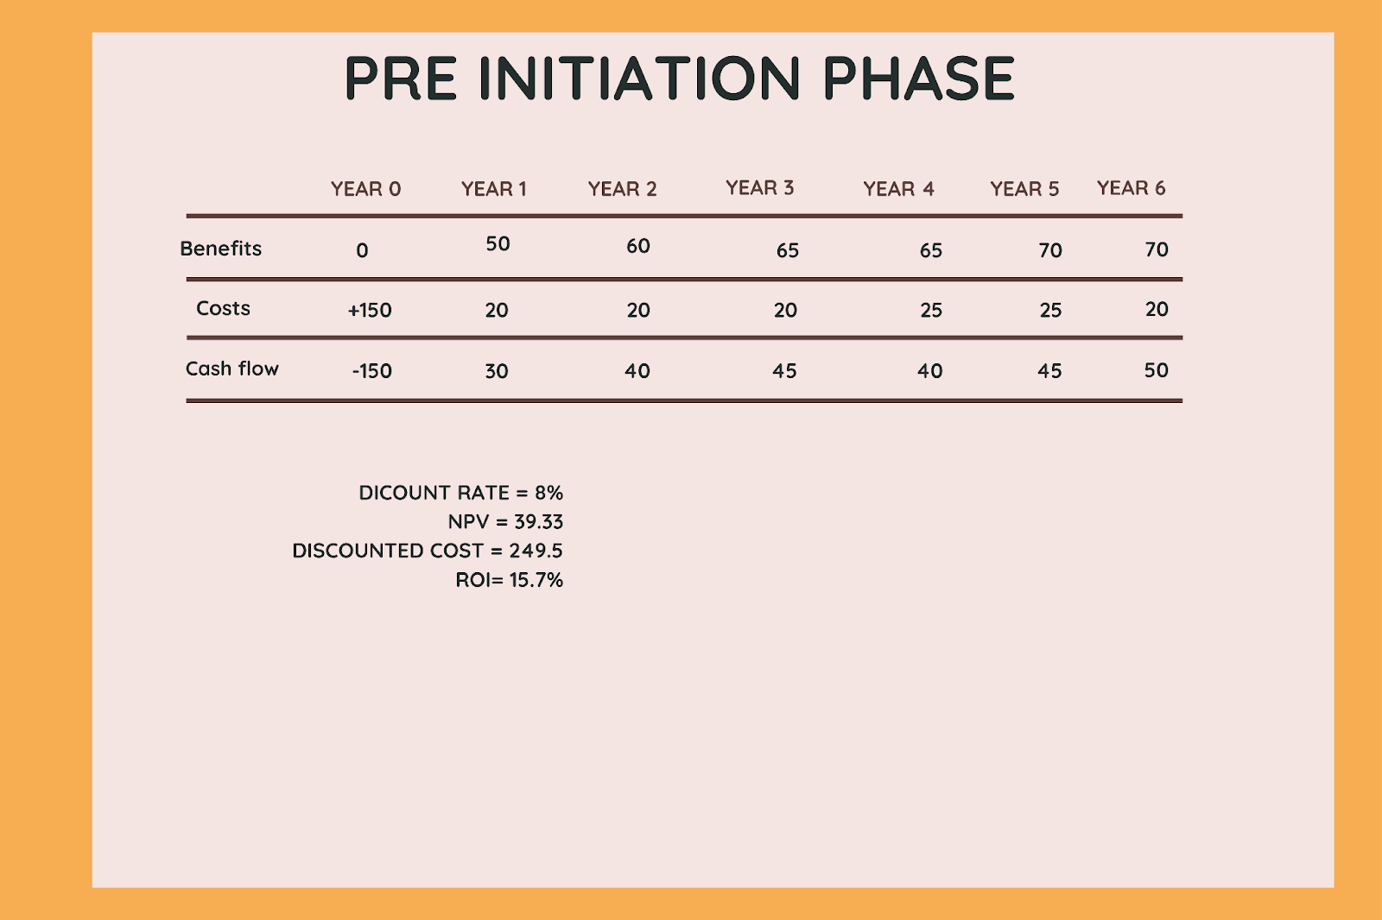
Pre-Initiation Phase
We estimate the revenues and the costs that our project will be generating and calculated the NPV, ROI and Payback period.

Slide 4
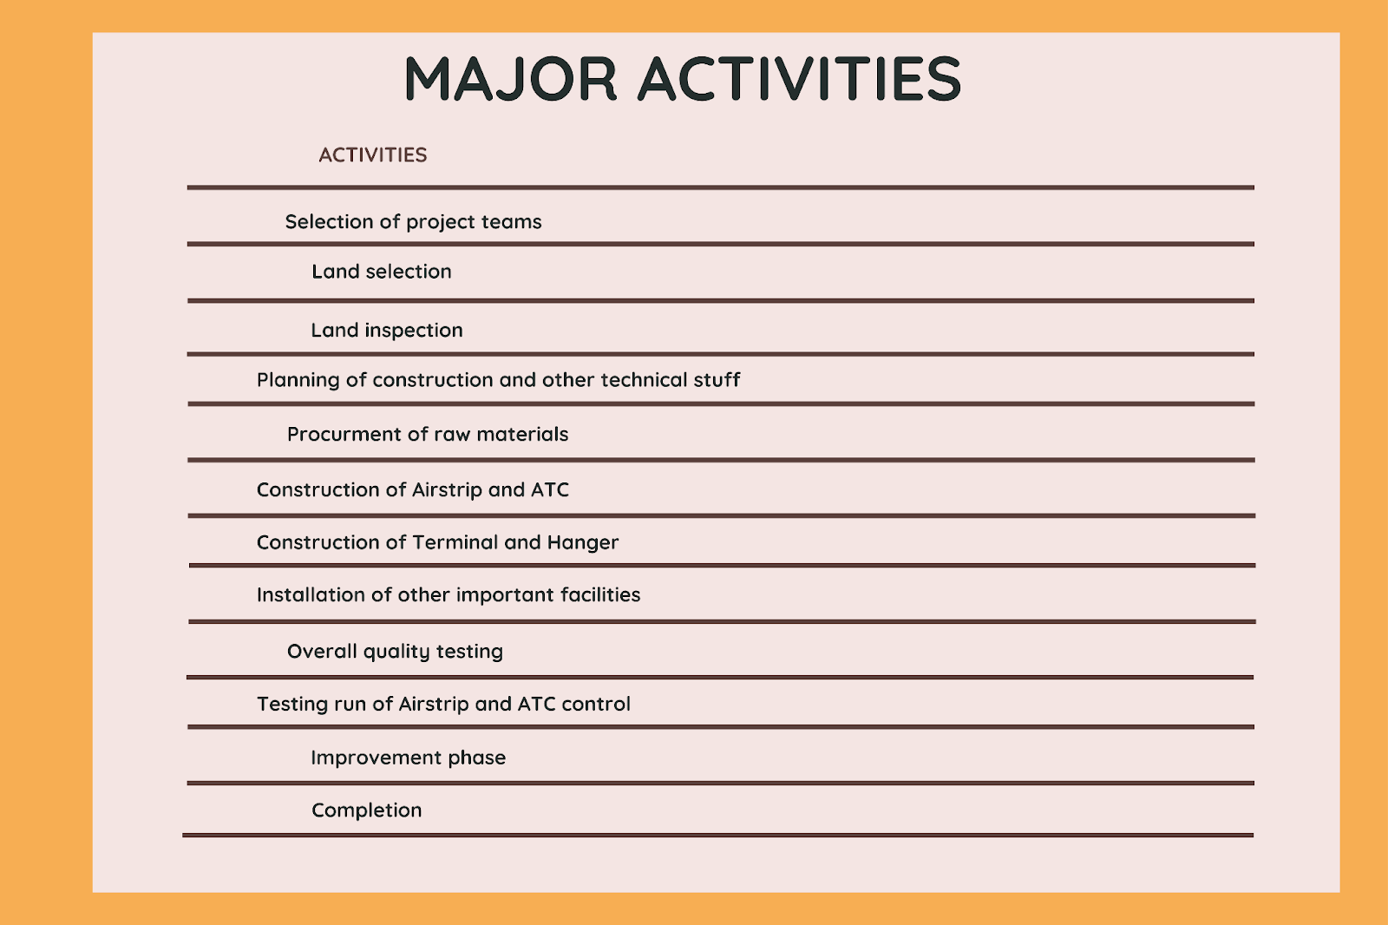
Major Activities
These are the major activities that will take place during the project phases.

Slide 5
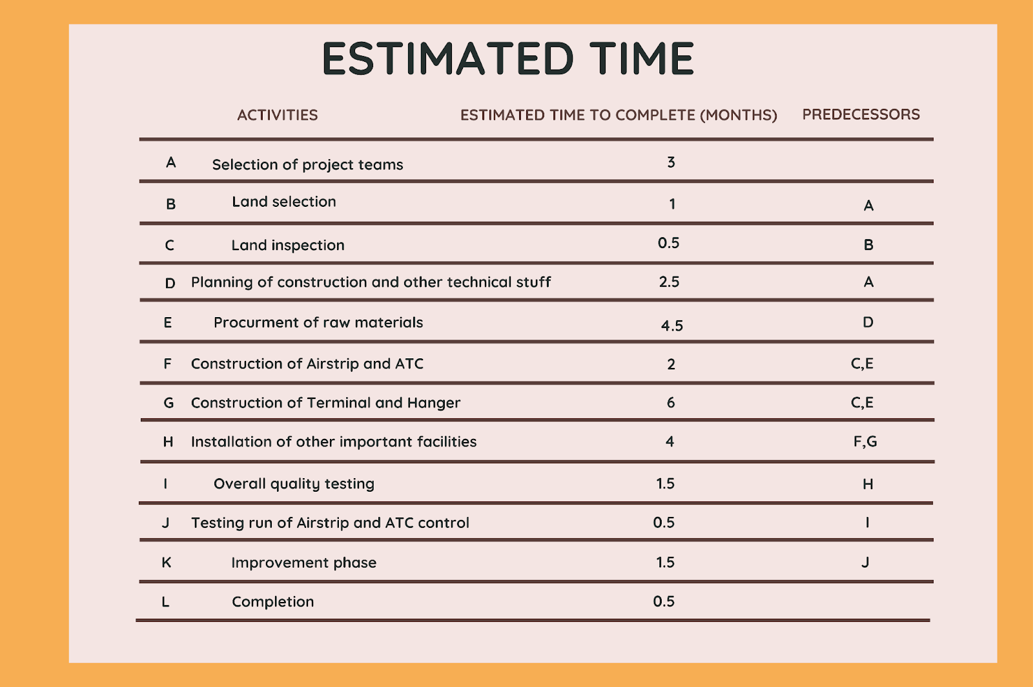
Estimated Time
These are the major activities that will take place during the project phases.

Slide 6
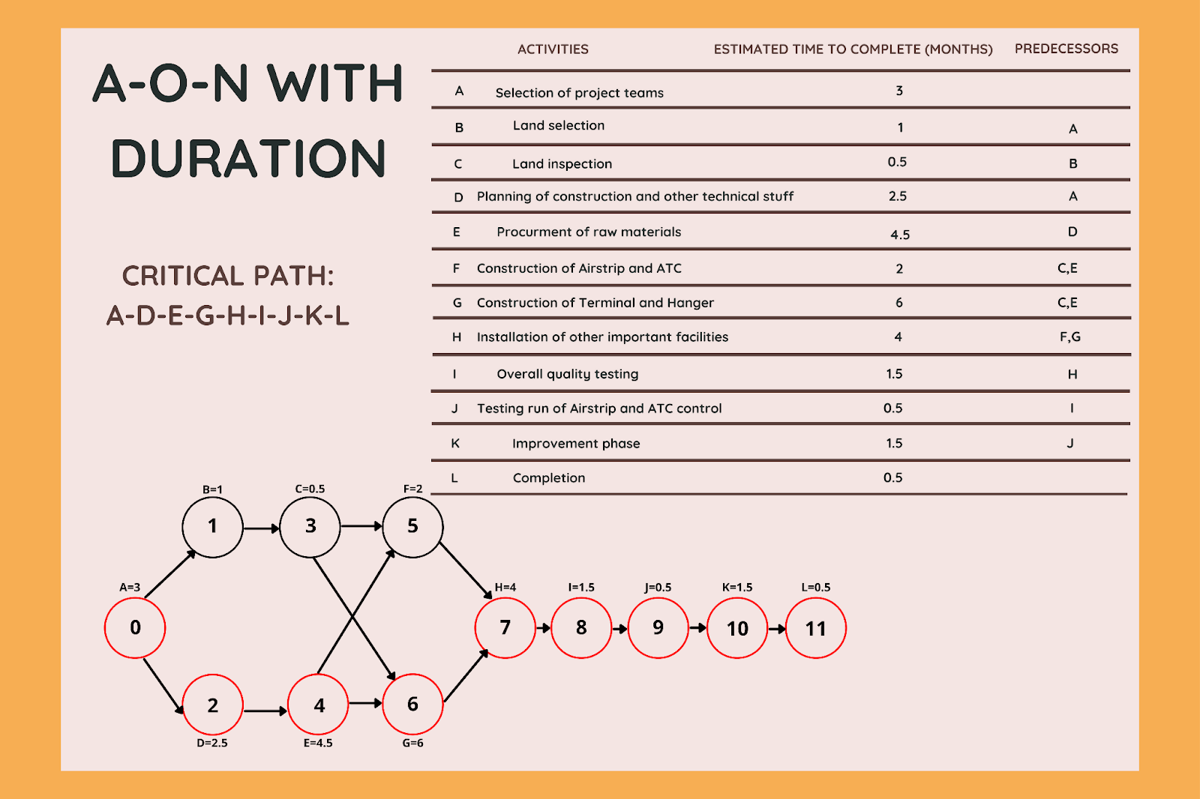
Network Diagram for the major activities
Critical path RED

Slide 7
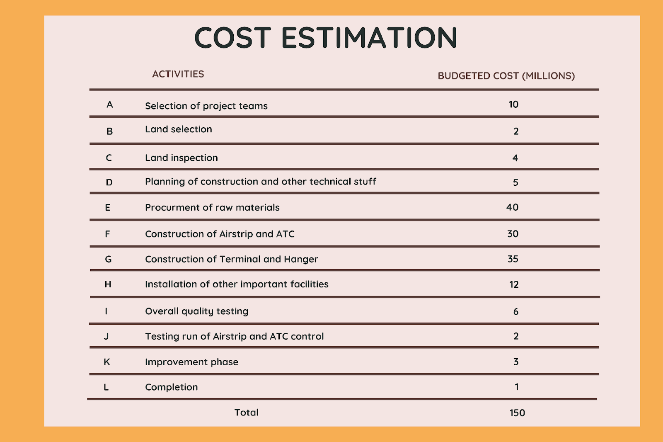
COST Estimations

Slide 8
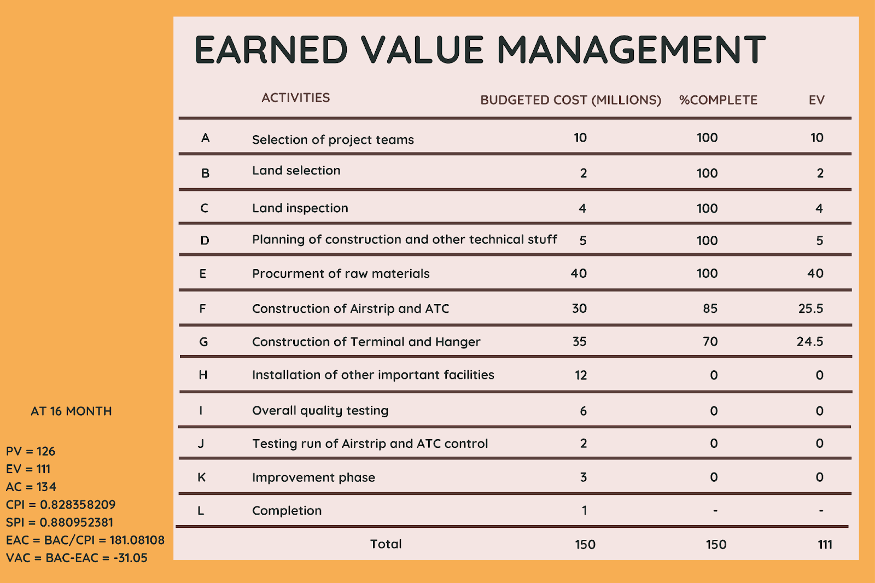
Evaluation of the project (Earned Value Management)

Slide 9
Risk Breakdown Structure

Slide 10
Quality
Tools | Description
Project Budget | There is no cost overrun
Duration | Completed within the time span
Accuracy | With some additional change we were able to get the desired accuracy
Monitoring and Controlling | The changes made after monitoring helped a lot
Deliverables | Were delivered as per time & written instructions
Acceptance / Closing | After the acceptance from stakeholders we closed the project but maintenance is still an undergoing process

Slide 11
MS PROJECT Live Demo

